Slide 1
Introducción a la
Programación con Python
Condicionales

Slide 2
>
>=
<
<=
==
!=

Slide 3
if
Notes:
compare0.py

Slide 4
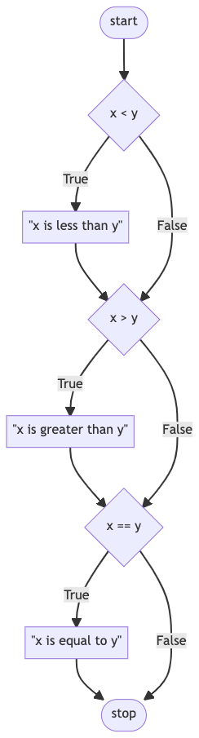
Notes:
flowchart TD
A([start]) --> B{x < y}
B -- True --> C["#quot;x is less than y#quot;"]
C --> D{x > y}
D -- True --> E["#quot;x is greater than y#quot;"]
E --> F{x == y}
F -- True --> G["#quot;x is equal to y#quot;"]
G --> H([stop])
B -- False --> D
D -- False --> F
F -- False --> H

Slide 5
elif
Notes:
compare1.py

Slide 6

Notes:
flowchart TD
A([start]) --> B{x < y}
B -- True --> C["#quot;x is less than y#quot;"]
C --> D{x > y}
D -- True --> E["#quot;x is greater than y#quot;"]
E --> F{x == y}
F -- True --> G["#quot;x is equal to y#quot;"]
G --> H([stop])
B -- False --> D
D -- False --> F
F -- False --> H

Slide 7
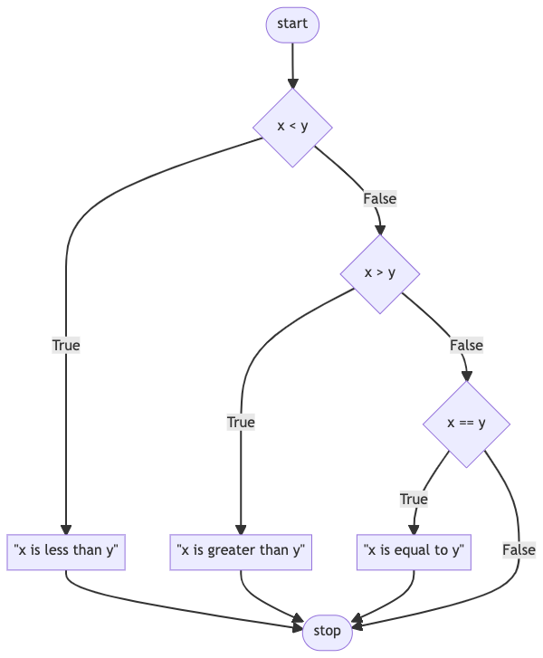
Notes:
flowchart TD
A([start]) --> B{x < y}
B -- True --> C["#quot;x is less than y#quot;"]
B -- False --> D{x > y}
D -- True --> E["#quot;x is greater than y#quot;"]
D -- False --> F{x == y}
F -- True --> G["#quot;x is equal to y#quot;"]
G --> H([stop])
F -- False --> H
C --> H
E --> H

Slide 8
else
Notes:
compare2.py

Slide 9
Notes:
flowchart TD
A([start]) --> B{x < y}
B -- True --> C["#quot;x is less than y#quot;"]
B -- False --> D{x > y}
D -- True --> E["#quot;x is greater than y#quot;"]
D -- False --> F{x == y}
F -- True --> G["#quot;x is equal to y#quot;"]
G --> H([stop])
F -- False --> H
C --> H
E --> H

Slide 10
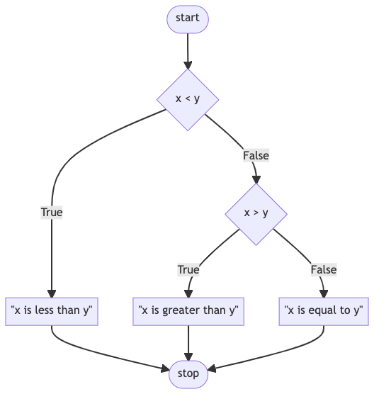
Notes:
flowchart TD
A([start]) --> B{x < y}
B -- True --> C["#quot;x is less than y#quot;"]
B -- False --> D{x > y}
D -- True --> E["#quot;x is greater than y#quot;"]
D -- False --> F["#quot;x is equal to y#quot;"]
F --> G([stop])
C --> G
E --> G

Slide 11
or
Notes:
compare3.py

Slide 12
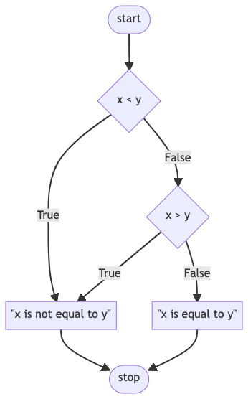
Notes:
compare4.py
flowchart TD
A([start]) --> B{x < y}
B -- True --> C["#quot;x is not equal to y#quot;"]
B -- False --> D{x > y}
D -- True --> C
D -- False --> E["#quot;x is equal to y#quot;"]
E --> F([stop])
C --> F

Slide 13
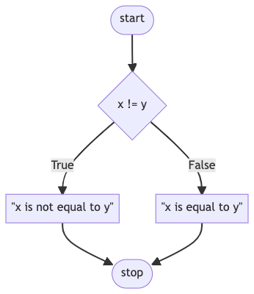
Notes:
flowchart TD
A([start]) --> B{x != y}
B -- True --> C["#quot;x is not equal to y#quot;"]
B -- False --> E["#quot;x is equal to y#quot;"]
C --> F([stop])
E --> F

Slide 14
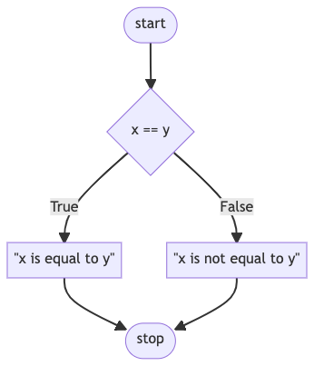
Notes:
compare5.py
flowchart TD
A([start]) --> B{x == y}
B -- True --> C["#quot;x is equal to y#quot;"]
B -- False --> E["#quot;x is not equal to y#quot;"]
C --> F([stop])
E --> F

Slide 15
and
Notes:
grade{0,1,2,3}.py

Slide 16
+
-
*
/
%
Notes:
parity0.py

Slide 17
bool

Slide 18
True
False
Notes:
parity{1,2,3}.py

Slide 19
match
Notes:
Structural Pattern Matching
house{0,1,2,3}.py
Splice in at 3:44:38ish in https://www.youtube.com/embed/TJKnZ784bSI, then cut back to "So just by adding…".

Slide 20
Introducción a la
Programación con Python
Condicionales

